Slide 1
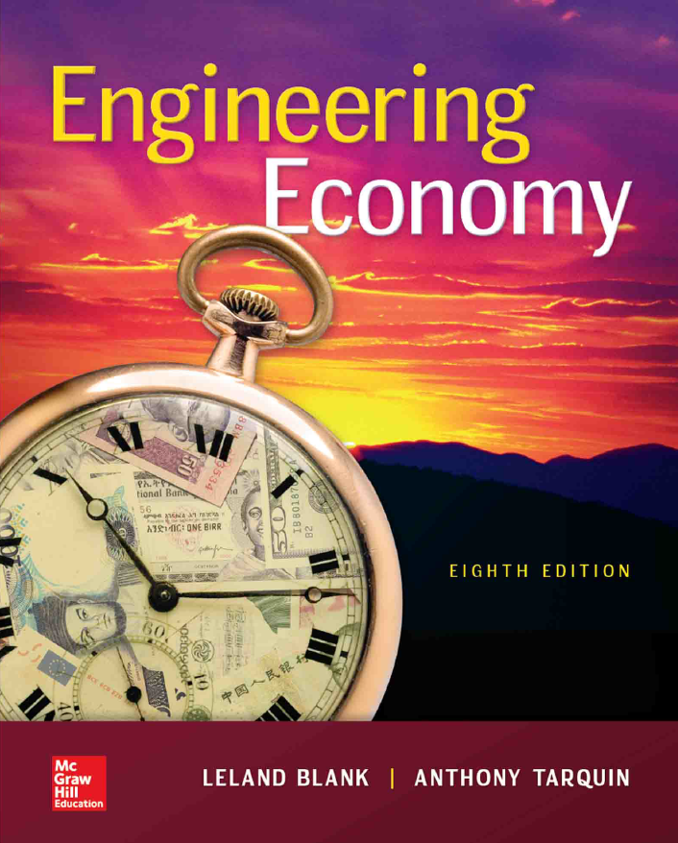

Chapter 4
Nominal and Effective Interest Rates
Lecture slides to accompany
Engineering Economy
8th edition
Leland Blank
Anthony Tarquin
4-<number>

Slide 2
LEARNING OUTCOMES
Understand interest rate statements
Use formula for effective interest rates
Determine interest rate for any time period
Determine payment period (PP) and compounding period (CP) for equivalence calculations
Make calculations for single cash flows
Make calculations for series and gradient cash flows with PP ≥ CP
Perform equivalence calculations when PP < CP
Use interest rate formula for continuous compounding
Make calculations for varying interest rates
4-<number>

Slide 3

Interest Rate Statements
The terms ‘ ’ and ‘ ’ enter into consideration
when the interest period is less than one year.
New time-based definitions to understand and remember
Interest period (t) – period of time over which interest is expressed. For example,
1% per ________.
Compounding period (CP) – Shortest time unit over which interest is charged or earned.
For example,10% per year compounded ______________.
Compounding frequency (m) – Number of times compounding occurs within the interest
period t. For example, at i = 10% per year, compounded
monthly, interest would be compounded ___ times during the
one year interest period.
4-<number>

Slide 4
Understanding Interest Rate Terminology
A interest rate (r) is obtained by multiplying an interest rate that is
expressed over a short time period by the number of compounding periods in a longer time period: That is:
r = interest rate per period x number of compounding periods
Example: If i = 1% per month, nominal rate per year is
r = (1)(12) = 12% per year)
interest rates (i) take compounding into account (effective rates can be obtained from nominal rates via a formula to be discussed later).
IMPORTANT: Nominal interest rates are essentially simple interest rates. Therefore,
they can be used in interest formulas.
Effective rates must be used hereafter in all interest formulas.
APR(Annual Percentage Rate) vs. APY(Annual Percentage Yield)
4-<number>

Slide 5
More About Interest Rate Terminology
There are 3 general ways to express interest rates as shown below
Sample Interest Rate Statements Comment
i = 2% per month
When no compounding period
is given, rate is
(1)
i = 12% per year
(2)
i = 12% per year, comp’d semiannually
i = 12% per year, comp’d monthly
When compounding period is given
and it is not the same as interest
period, it is
i = effective 9.4%/year, comp’d semiannually
When compounding period is given
and rate is specified as effective,
rate is over stated period
(3)
i = effective 4% per quarter, comp’d monthly
4-<number>

Slide 6
Effective Annual Interest Rates
Effective rates are converted into effective annual rates via the equation:
i_{a} = = – 1 = – 1
where i_{a} = effective annual interest rate
i = effective rate for one compounding period
m = number times interest is compounded per year
Example: For a nominal interest rate of 12% per year, determine the nominal and effective rates per year for (a) quarterly, and (b) monthly compounding
Solution:
(a) Nominal r / year = 12% per year
Nominal r / quarter = 12/4 = 3.0% per quarter = effective i per quarter
Effective i / year = (1 + 0.03)⁴ – 1 = 12.55% per year
(b) Nominal r / year = 12% per year
Nominal r /month = 12/12 = 1.0% per month
Effective i / year = (1 + 0.01)¹² – 1 = 12.68% per year
4-<number>

Slide 7
Effective Interest Rates
Nominal rates can be converted into effective rates
for any time period via the following equation:
i = – 1
where i = effective interest rate for any time period
r = nominal rate for same time period as i
m = no. times interest is comp’d in period specified for i
Spreadsheet function is = (r%,m) where r = nominal rate per period specified for i
Example: For an interest rate of 1.2% per month, determine the nominal
and effective rates (a) per quarter, and (b) per year
Solution:
(a) Nominal r / quarter = (1.2)(3) = 3.6% per quarter
Effective i / quarter = (1 + 0.036/3)³ – 1 = ____% per quarter
(b) Nominal i /year = (1.2)(12) = 14.4% per year
Effective i / year = (1 + 0.144 / 12)¹² – 1 = _____% per year
4-<number>

Slide 8
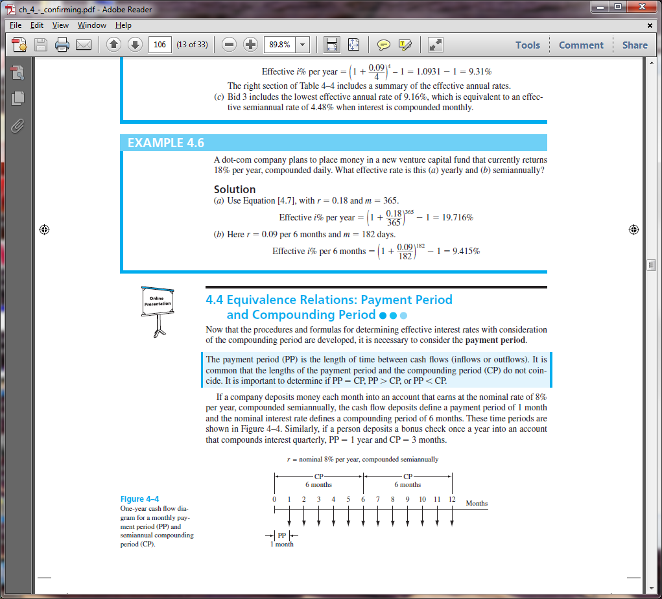
Equivalence Relations: PP and CP
New definition: Payment Period (PP) – Length of time between cash flows
In the diagram below, the compounding period (CP) is and the payment period (PP) is
$1000
Similarly, for the diagram below, the CP is quarterly and the payment period (PP) is semiannual
i = 10% per year, compounded quarterly
F = ?
0 1 2 3 4 5
Years
0 1 2 3 4 5 6 7 8
Semi-annual periods
A = $8000
Semi-annual PP
4-<number>

Slide 9

Single Amounts with PP > CP
For problems involving single amounts, the payment period (PP) is usually
longer than the compounding period (CP). For these problems, there are an infinite
number of i and n combinations that can be used, with only two restrictions:
(1) The i must be an interest rate, and
(2) The time units on n must be as those of i
(i.e., if i is a rate per quarter, then n is the number of quarters between P and F)
There are two equally correct ways to determine i and n
Method 1: Determine effective interest rate over the compounding period CP, and
set n equal to the number of compounding periods between P and F
Method 2: Determine the effective interest rate for any time period t, and
set n equal to the total number of those same time periods.
4-<number>

Slide 10
Example: Single Amounts with PP ≥ CP
How much money will be in an account in 5 years if $10,000 is deposited
now at an interest rate of 1% per month? Use three different interest
rates: (a) monthly, (b) quarterly , and (c) yearly.
For monthly rate, 1% is effective [n = (5 years)×(12 CP per year = 60]
F = 10,000(F/P,1%,60) = $18,167
months
i and n must always
have same time units
effective i per month
(b) For a quarterly rate, effective i/quarter = (1 + 0.03/3)³ –1 = 3.03%
F = 10,000(F/P,3.03%,20) = $18,167
quarters
i and n must always
have same time units
effective i per quarter
(c) For an annual rate, effective i/year = (1 + 0.12/12)¹² –1 = 12.683%
F = 10,000(F/P,12.683%,5) = $18,167
years
i and n must always
have same time units
effective i per year
4-<number>

Slide 11
Series with PP ≥ CP
For series cash flows, first step is to determine relationship between PP and CP
Determine if PP ≥ CP, or if PP < CP
When PP ≥ CP, the only procedure (2 steps) that can be used is as follows:
First, find effective i per PP
Example: if PP is in quarters, must find effective i per _________
(2) Second, determine n, the number of A values involved
Example: quarterly payments for 6 years yields n = __×6 = 24
Note: Procedure when PP < CP is discussed later
4-<number>

Slide 12
Example: Series with PP ≥ CP
How much money will be accumulated in 10 years from a deposit
of $500 every 6 months if the interest rate is 1% per month?
Solution:
First, find relationship between PP and CP
PP = six months, CP = one month; Therefore, PP > CP
Since PP > CP, find effective i per PP of six months
Step 1. i /6 months = (1 + 0.06/6)⁶ – 1 = 6.15%
Next, determine n (number of 6-month periods)
Step 2: n = 10(2) = 20 six month periods
Finally, set up equation and solve for F
F = 500(F/A,6.15%,20) = $18,692 (by factor or spreadsheet)
4-<number>

Slide 13
Series with PP < CP
Two policies: (1) interperiod cash flows earn no interest (most common)
(2) interperiod cash flows earn compound interest
For policy (1), positive cash flows are moved to
of the interest period in which they occur
and negative cash flows are moved to the of the interest period
For policy (2), cash flows are not moved and equivalent P, F, and A values are
determined using the effective interest rate per payment period
4-<number>

Slide 14
Example: Series with PP < CP
A person deposits $100 per month into a savings account for 2 years. If $75 is withdrawn in months 5, 7 and 8 (in addition to the deposits), construct the cash flow diagram to determine how much will be in the account after 2 years at i = 6% per year, compounded quarterly. Assume there is no interperiod interest.
Solution:
Since PP < CP with no interperiod interest, the cash flow diagram must be
changed using quarters as the time periods
F = ?
75
75
75
F = ?
____
____
from
to
0 1 2 3 4 5 6 7 8 9 10
21 24
Months
0 1 2 3 4 5 6 7 8 9 10
23 24
1 2 3 7 8
Quarters
this
this
100
____
300
300
300
300
4-<number>

Slide 15
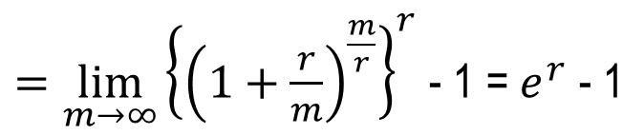

Continuous Compounding
When the interest period is infinitely small, interest is
compounded continuously. Therefore, PP > CP and m increases.
Take limit as m → ∞ to find the effective interest rate equation
i = e^{r} – 1
i = (1 + r / m)^{m} – 1
where i = effective interest rate for any time period
r = nominal rate for same time period as i
m = no. times interest is comp’d in period specified for i
4-<number>

Slide 16
Continuous Compounding
When the interest period is infinitely small, interest is
compounded continuously. Therefore, PP > CP and m increases.
Take limit as m → ∞ to find the effective interest rate equation
i = – 1
Example: If a person deposits $500 into an account every 3 months
at an interest rate of 6% per year, compounded continuously,
how much will be in the account at the end of 5 years?
Solution: Payment Period: PP = 3 months
Nominal rate per three months: r = 6%/4 = 1.50%
Effective rate per 3 months: i = e^{0.015} – 1 = 1.51%
F = 500(F/A,1.51%,20) = $11,573
4-<number>

Slide 17
Varying Rates
When interest rates vary over time, use the interest rates
associated with their respective time periods to find P
Example: Find the present worth of $2500 deposits in years 1 through 8 if the
interest rate is 7% per year for the first five years and 10% per year thereafter.
For the cash flow shown below, find the future worth (in year 7) at i = 10% per year.
Solution:
P = 2,500(P/A,7%,5) + 2,500(P/A,10%,3)(P/F,7%,5)
= $14,683
An equivalent annual worth value can be obtained by replacing each cash flow
amount with ‘A’ and setting the equation equal to the calculated P value
14,683 = A(P/A,7%,5) + A(P/A,10%,3)(P/F,7%,5)
A = $2500 per year
4-<number>

Slide 18


Summary of Important Points
Must understand: interest period, compounding period, compounding
frequency, and payment period
i = (1 + r / m)^{m} – 1
Always use __________ rates in interest formulas
Interest rates are stated different ways; must know how to get effective rates
For single amounts, make sure units on i and n are the same
4-<number>

Slide 19

Important Points (cont’d)
For uniform series with PP ≥ CP, find effective i over PP
For uniform series with PP < CP and no interperiod interest, move cash flows to match compounding period
For continuous compounding, use i = ____ – 1 to get effective rate
For the cash flow shown below, find the future worth (in year 7) at i = 10% per year.
For varying rates, use stated i values for respective time periods
4-<number>

Slide 20
HOMEWORK
Please solve every Examples in your textbook. You do not have to submit your works.
Please upload following “PROBLEMS” solution file on “Assignment” menu in e-Class.
  4.14
  4.44
  4.49
  4.56
  4.61
  4.74
  4.81
4-<number>

